Slide 1
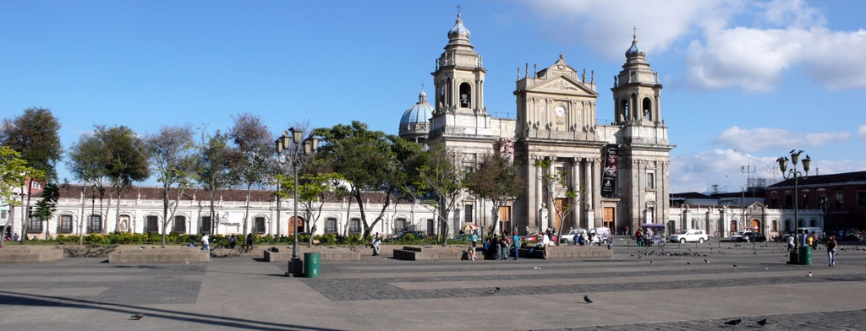
Taking Digital Humanities to Guatemala, A Case Study in the Preservation of Colonial Musical Heritage
Martha E. Thomae, Julie E. Cumming, and Ichiro Fujinaga
Distributed Digital Music Archives and Libraries (DDMAL) Lab, McGill University
Digital Humanities Conference
Utrecht, July 10th, 2019
Notes:
For the past 4 years, I have been working at the Distributed Digital Music Archives and Libraries Lab (DDMAL Lab), at McGill Univ.
@DDMAL develop technologies for digital musical archives to make their images searchable not only by their metadata, but also by the music content.
My goal is to apply these technologies to the music of my home country: Guatemala
TO Encode the music content of a set of manuscripts to preserve it and make it accessible both inside and outside of the country

Slide 2
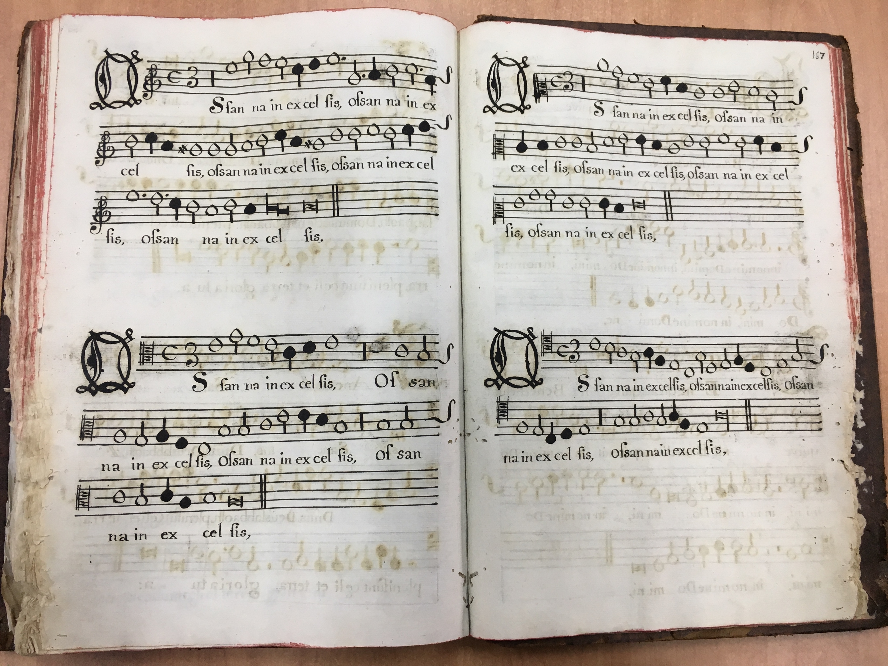
Guatemalan Choirbooks
6 manuscripts copied between XVII - XVIII
Choirbook format
Written in mensural notation
Music notation system used in Europe throughout the Late Middle Ages and the Renaissance
SUPERIUS
ALTUS
TENOR
BASSUS
Notes:
The sources I will be working with are A COLLECTION OF
SIX manuscript sources
Copied between the XVII and XVIII centuries
These MSS are choirbooks, that means they are written in choirbook format
And using an old system of music notation called mensural notation. This system was used in Europe throughout the … (brought to Guatemala in the XVII)

Slide 3
Barriers for Accessing the Music
Lack of high-quality digital images
Notation style (mensural notation)
Layout (choirbook format)
Notes:
Preservation & Increasing Access to the music contained in these choirbooks
Soooo… I consider there are 3 barriers for accessing the music content of these choirbooks have :
WHY THESE REPRESENT ISSUES
Lack of digital images → access restricted to people able to visit
Modern musicians can not interpret it.
In order to determine the length of the notes (their durations) one needs to consider the context (the notes preceding and following)
You need an expert to interpret it
LAYOUT --> NEXT SLIDE

Slide 4
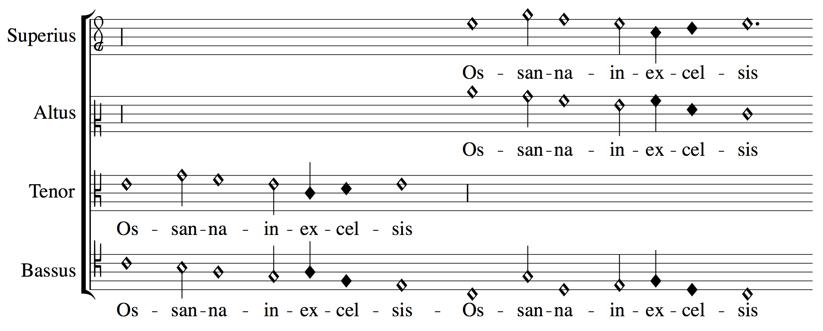
Barriers for Accessing the Music
SUPERIUS
ALTUS
Lack of high-quality digital images
Notation style (mensural notation)
Layout (choirbook format)
TENOR
BASSUS
Notes:
The layout doesn’t allow you to know which notes are sung together by the different voices at a particular time.
WHICH YOU WOULD KNOW IF THE PIECE WAS WRITTEN AS A SCORE
So, the issue is:
If you were in choirbook layout
To Know how the piece sounds like
4 experts in the notation singing each voice
OR 1 expert to transcribe the piece into a score
SO, AS I SAID BEFORE, THE IDEA IS REMOVING THESE ACCESIBILITY BARRIERS, USING THE MUSIC-ENCODING TECHNOLOGIES DEVELOPED AT THE DDMAL LAB

Slide 5
Process for Encoding the Music Content of the Choirbooks
Three stages:
Digitization
OMR
Optical Music Recognition (OMR) ≈ Optical Character Recognition (OCR)
Tool designed for the music notation of these choirbooks
Digitization
Optical Music Recognition
Mensural Scoring-up Tool
Lack of high-quality digital images
Notation style
Layout
Notes:
THE PROCESS WE WILL BE CONDUCTING TO ENCODE THE MUSIC CONTENT OF THESE MSS
Digitization --> obtain the digital images
Similar to OCR, but for recognizing music characters rather than text characters [other necessities]
A tool ...
I Will provide details of each of these steps later
THIS (1) SOLVES THE DIGITIZATION BARRIER
THIS (3) SOLVES THE OTHER TWO BARRIERS: NOTATION AND LAYOUT
THIS (2) IS THE STEP THAT CONNECTS THESE TWO (DIGITAL REPRESENTATION TO A SYMBOLIC ONE)

Slide 6
Process for Encoding the Music Content of the Choirbooks
Three stages:
Digitization
OMR
Optical Music Recognition (OMR) ≈ Optical Character Recognition (OCR)
Tool designed for the music notation of these choirbooks
Digitization
Optical Music Recognition
Mensural Scoring-up Tool
Guatemala
DDMAL Lab, McGill University
Notes:
1 → Done in Guatemala (actually I concluded this stage on January)
2 & 3 → conducted at
PILOT PROJECT

Slide 7
Digitization
(DIY Book Scanner)
Optical Music Recognition
(OMR)
Mensural Scoring-up Tool
Notes:
- Antiquity --> no flatbed scanner
- Book Scanner (cameras over head)
-> NO approp. for the large dimensions of the books
buying is not an option --> DIY [I am going to present now the details]

Slide 8
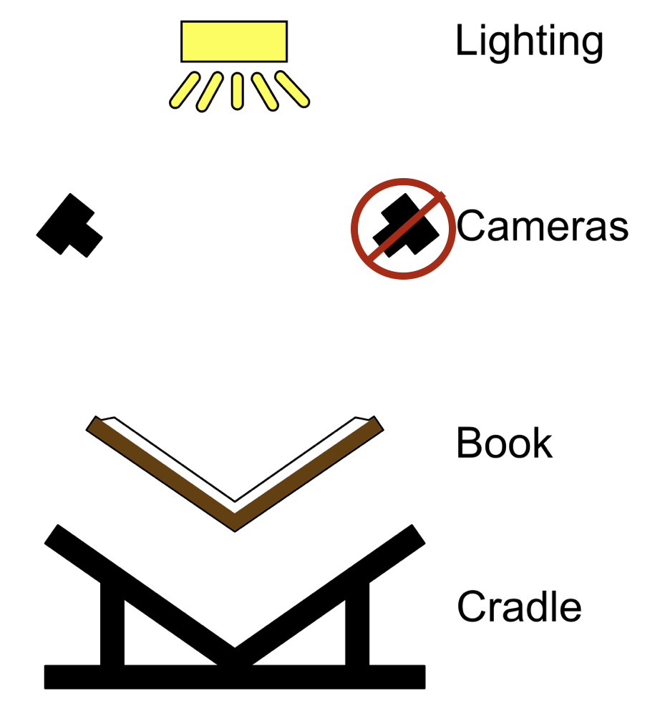
DIY Book Scanner
V-shaped book cradle
Built
Camera(s)
Borrowed from the McGill Music Library
Nikon D750 (24 Megapixels)
Images obtained have a 300 dpi resolution
Lighting
Borrowed from DDMAL Lab, McGill University
Two natural-light LED panels
DIY Book Scanner. “Book Scanner Rigs.”
http://diybookscanner.org
Notes:
1) Cradle → V-shaped:
To reduce the stress in the book’s spine
2) Cameras (Nikon D750 with 24 Megapixels = 6016 x 4016 pixels)
Perpendicular to the surface (the page) being photographed
You can have two for saving time
Or just one
You would just have to photographed all the versos first,
Then turn the book around,
And photograph all the rectos
3) Lighting
Resemble natural light
4) Glass platen → NO!
Everything was built or borrowed ☺
( And go through the details in the slide (build / borrow from & specificities) )

Slide 9
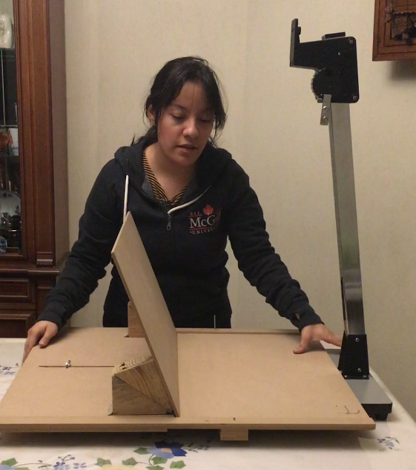
The V-Shaped Book Cradle (with copy stand)
Notes:
Cradle

Slide 10
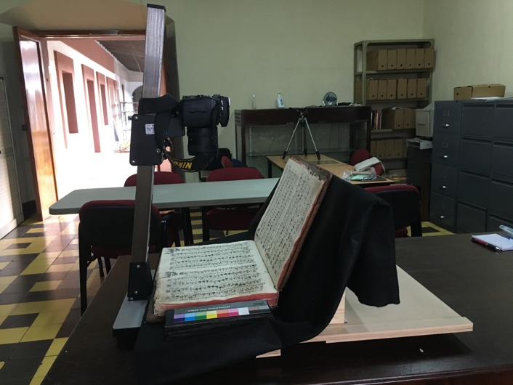
Cradle & Camera
Notes:
Cradle and camera

Slide 11
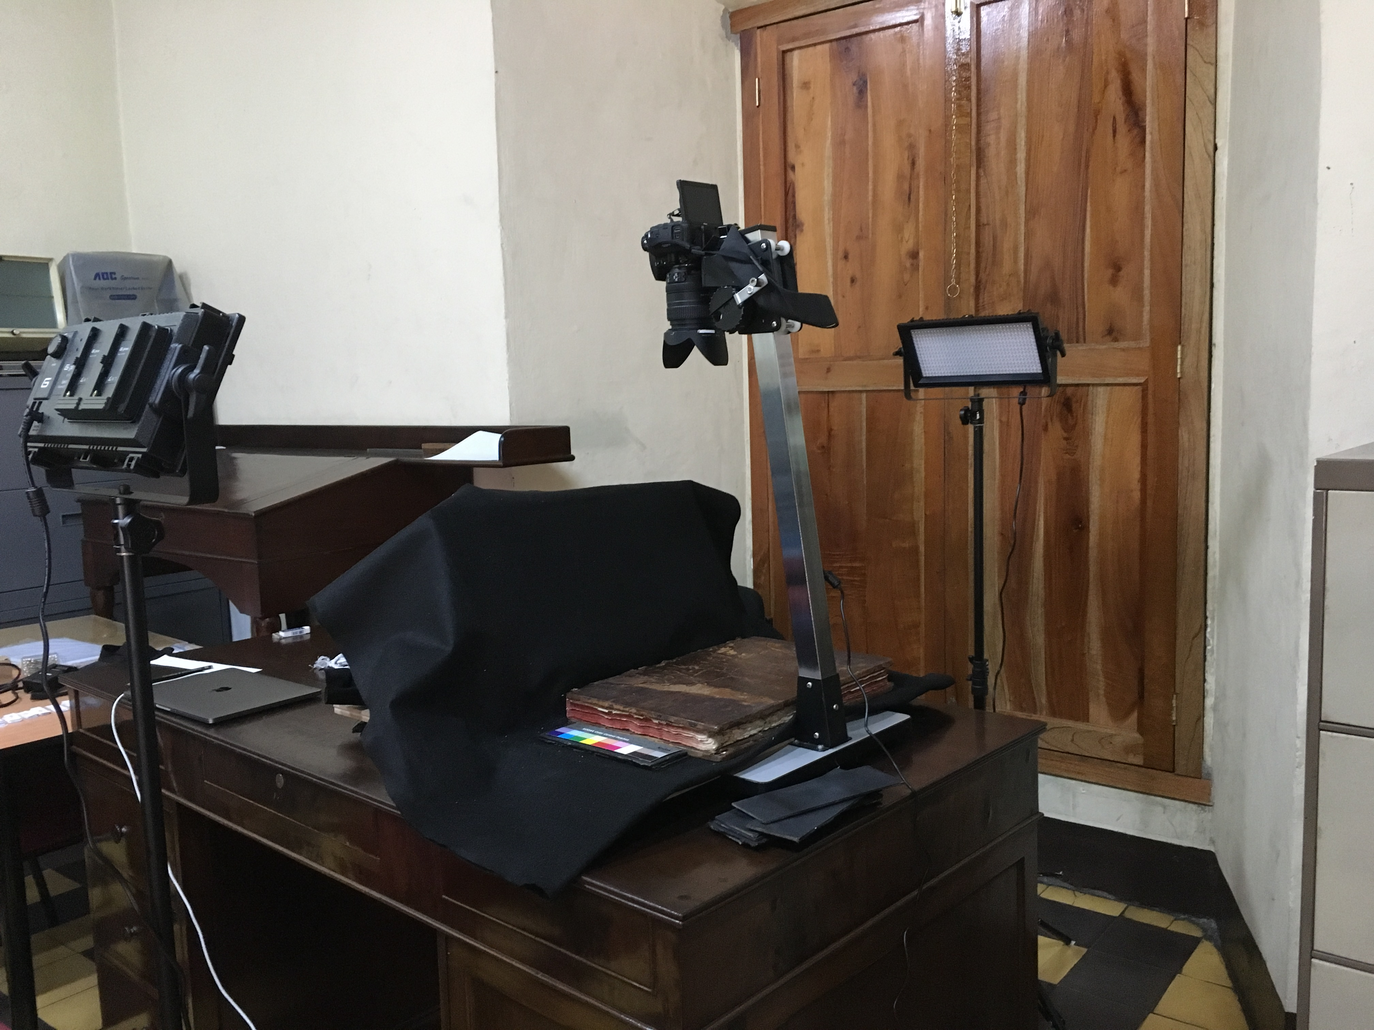
Lighting
Notes:
Both sides (even distribution of the light)
Angle

Slide 12
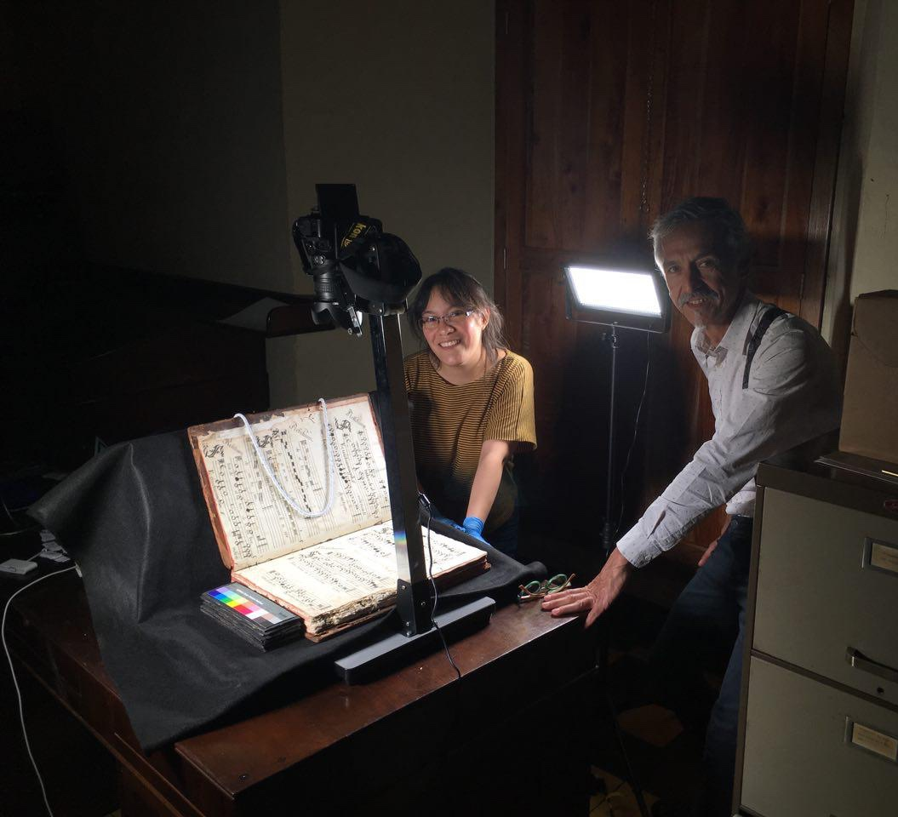
DIY Book Scanner
Advice from:
Digital Image Archive of Medieval Music (DIAMM)
Bibliothèque et Archives Nationales du Québec (BAnQ)
McGill Library

Slide 13
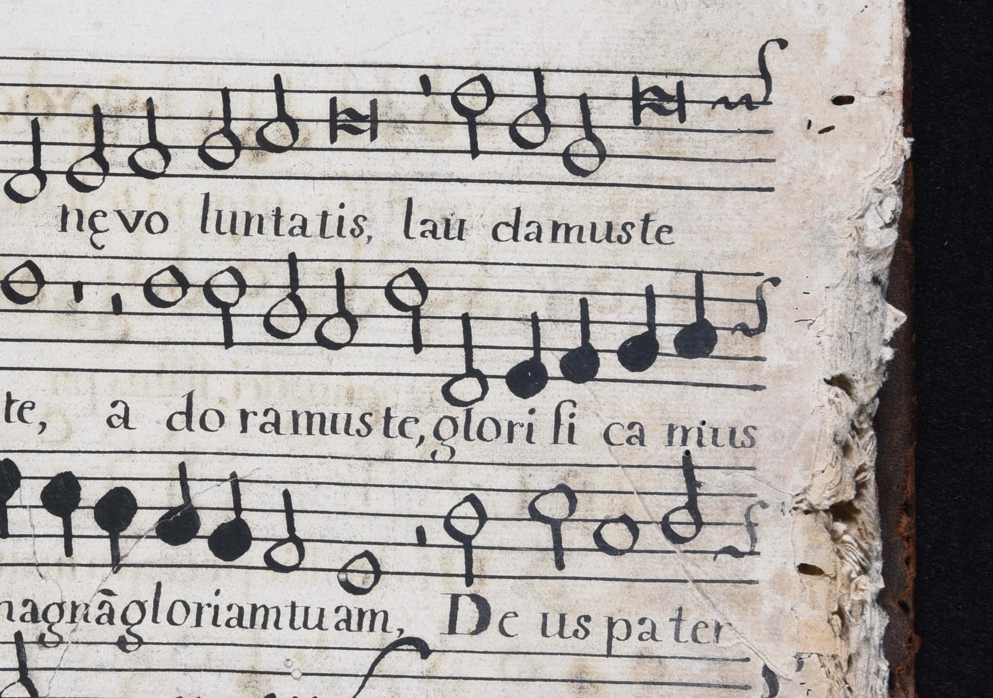
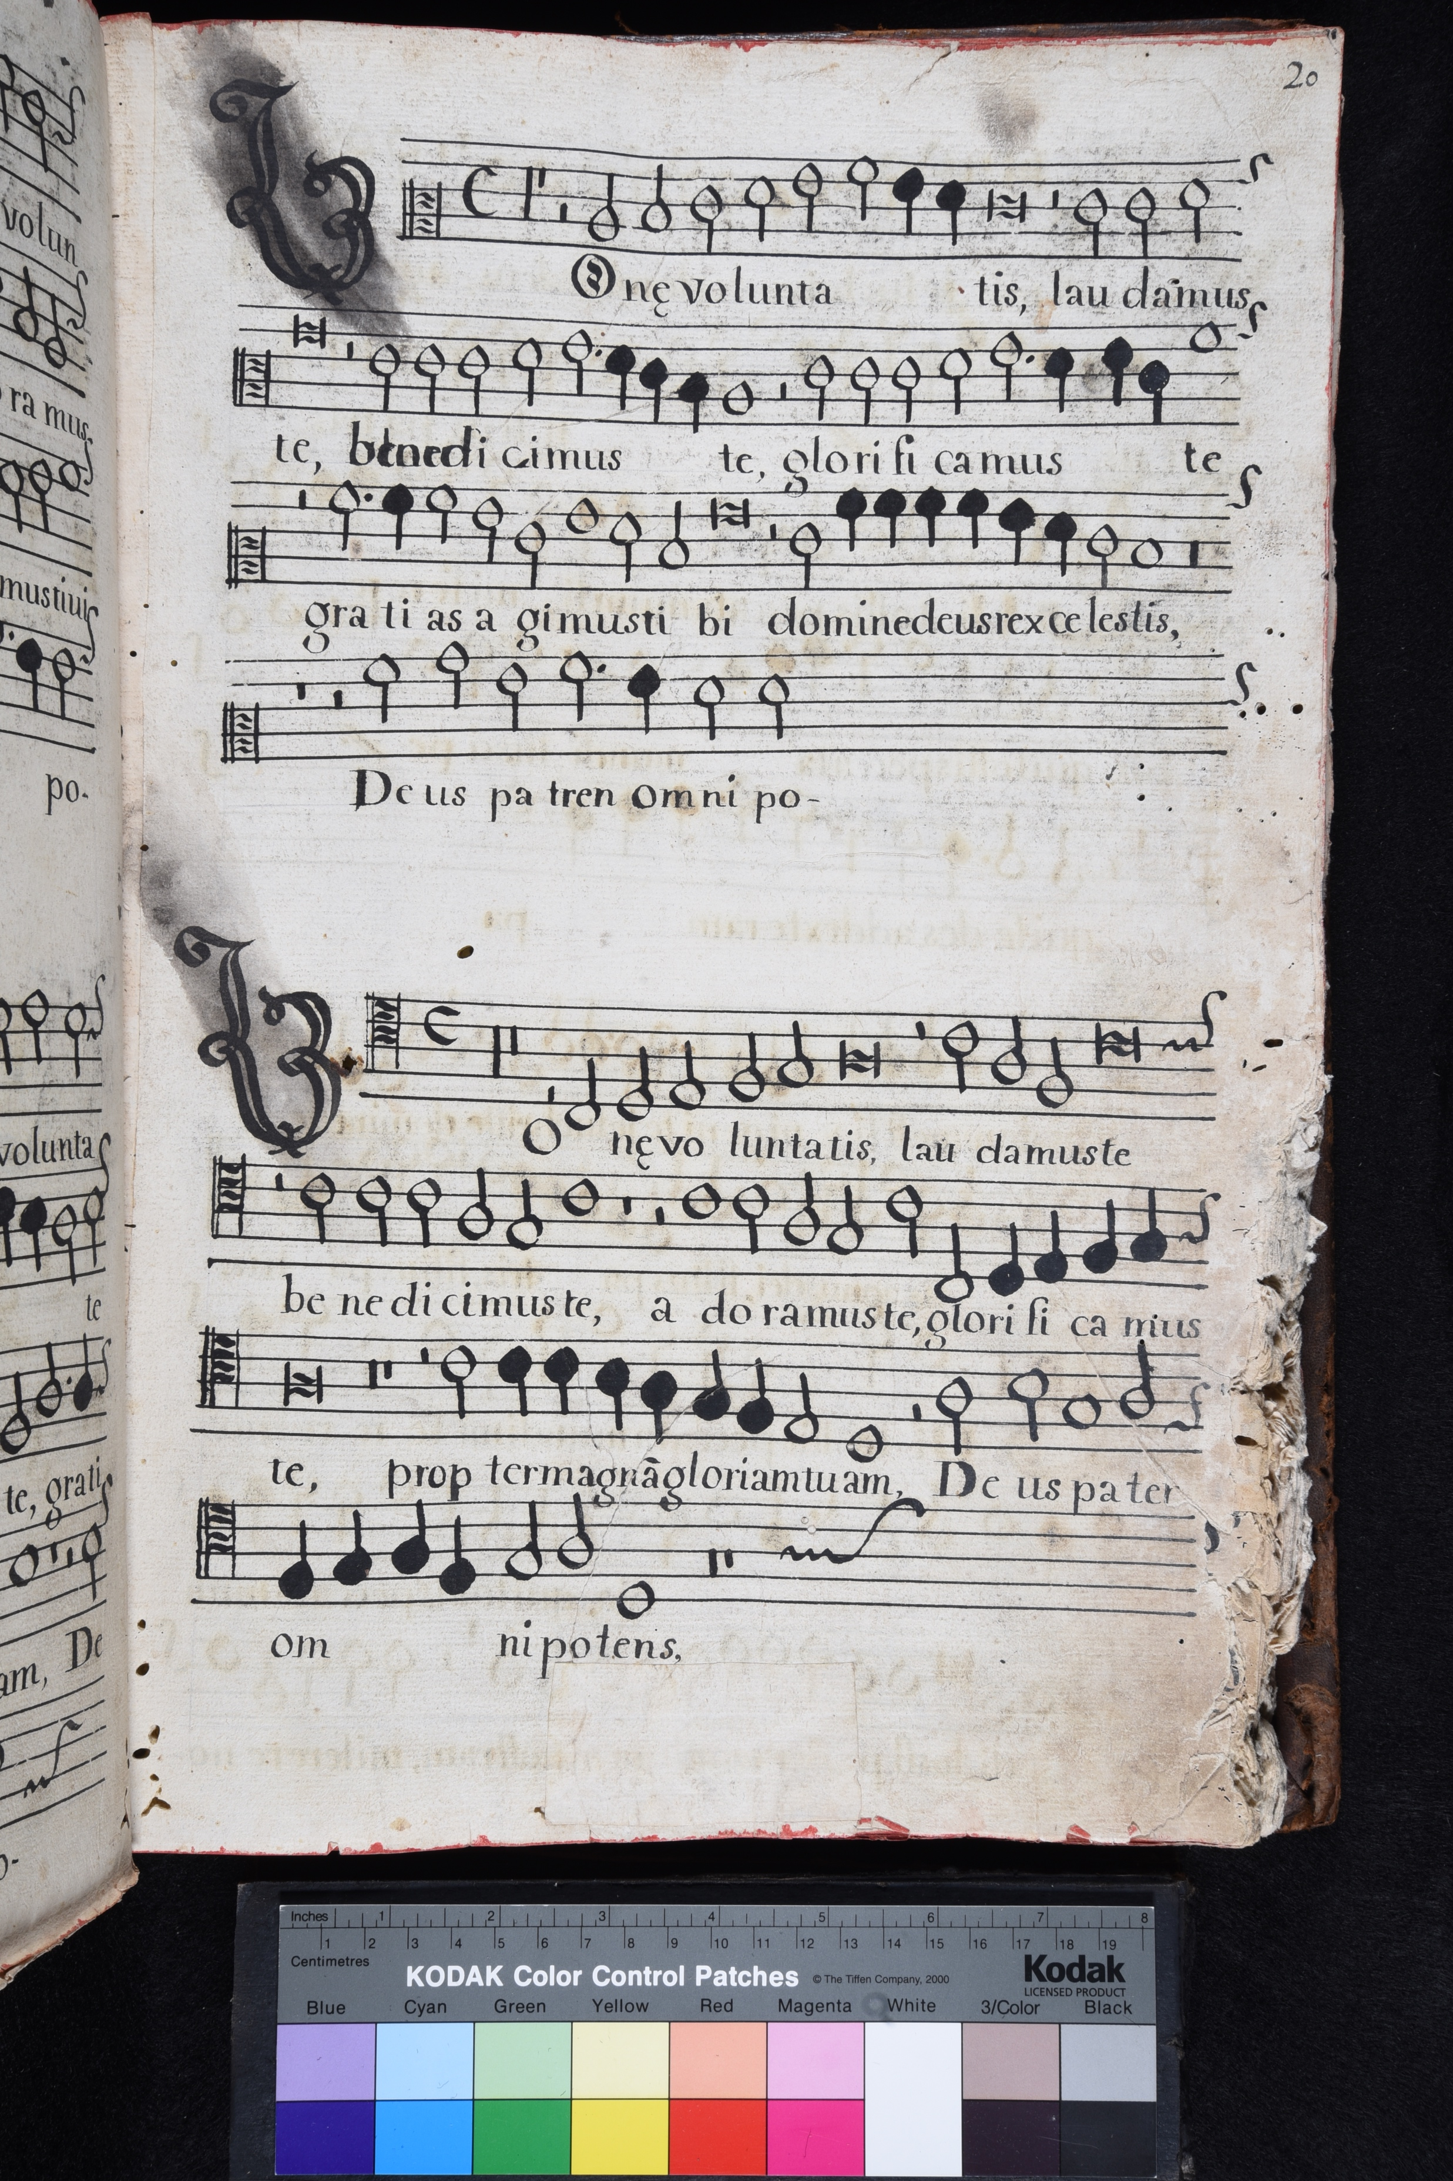

Slide 14
Digitization
(DIY Book Scanner)
Optical Music Recognition
(OMR)
Mensural Scoring-up Tool

Slide 15
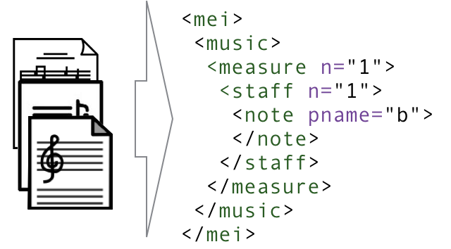
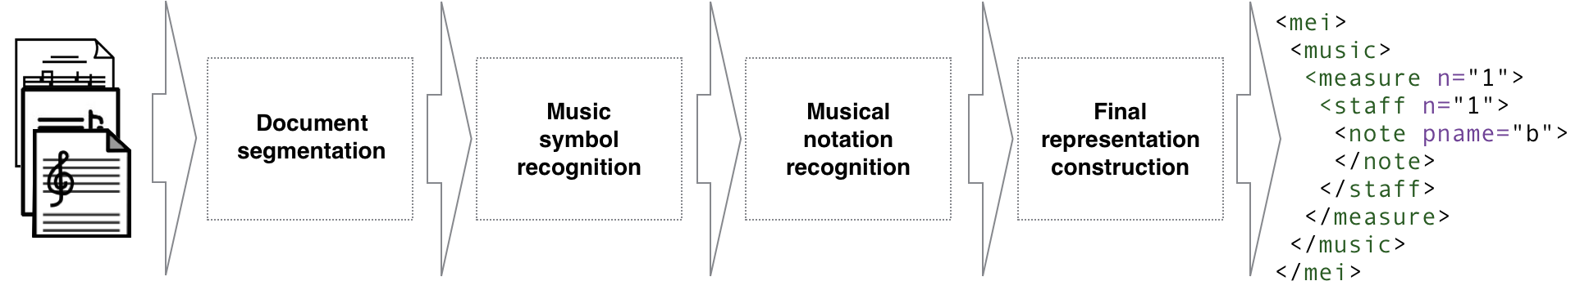
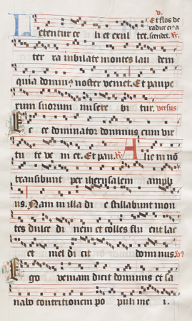
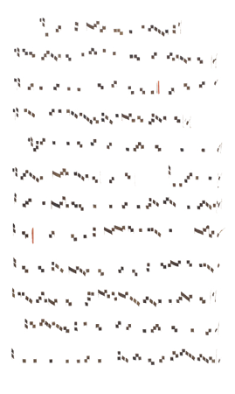

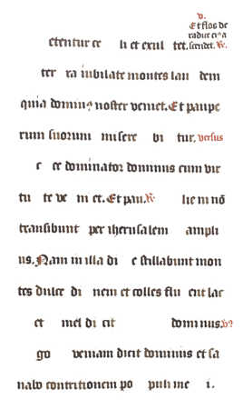
OMR Workflow
Vigliensoni, Gabriel, Jorge Calvo-Zaragoza, and Ichiro Fujinaga. "Developing an environment for teaching computers to read music." (2018).
Notes:
OMR does
Digital images of sheet music → MACHINE READABLE FORMAT (XML) that encodes the music
Workflow
Technologies for the different steps have been developed at DDMAL
Document segmentation → Separate the layers of music symbols, stafflines, and text
Use the music symbol layer alone for the next step. In which you give the software examples of the different CLASSES music symbols and then it learns based on those examples (DIFFERENT TYPES OF SYMBOLS) and classifies the rest of the page for you.
The symbols and the staff-lines are used together to find the pitch
SYMBOLIC FILE

Slide 16
Digitization
(DIY Book Scanner)
Optical Music Recognition
(OMR)
Mensural Scoring-up Tool

Slide 17
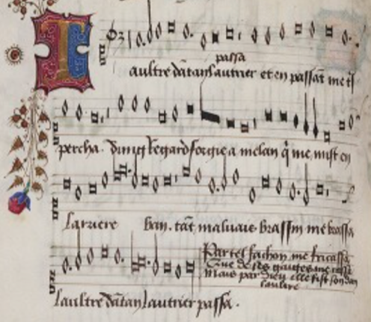
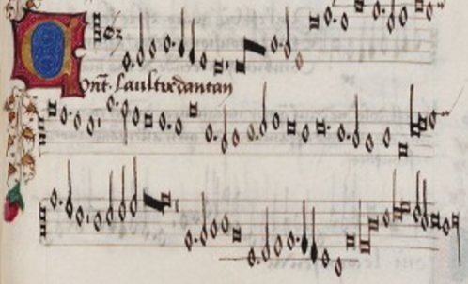
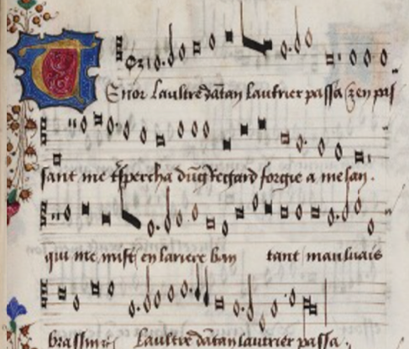
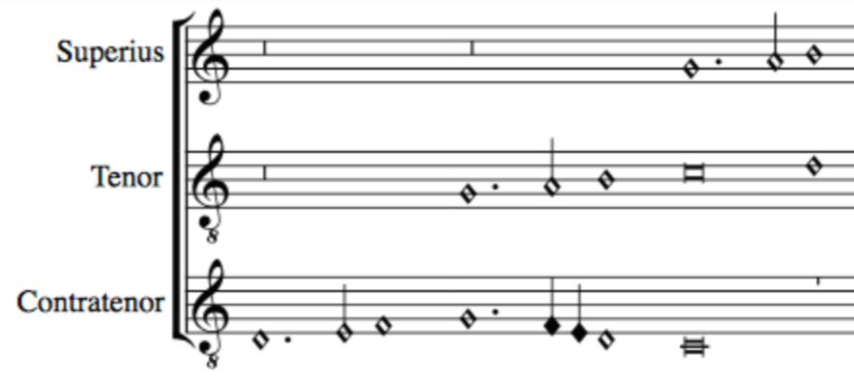
Pitch
Note shape
File 1
_______
_______
_______
Scoring-up
Tool
Duration based on context
Merge all files together
OMR
Output File
________
________
________
________
________
Superius part
OMR
File 2
_______
_______
_______
Contratenor part
SCORE
File 3
_______
_______
_______
OMR
Tenor part
Notes:
Last two barriers: notation and layout
EXPERT JOB OF INTERPRETING THE NOTE DURATION
& then PUTS EVERYTHING TOGETHER
Kept the original notation: Useful for EXPERTS
Original information + the relation between the voices
Which is useful for music theory studies
Because it is encoded:
- Easy to change this mensural note values to modern note values
- Allow to play the music back
→ Accessible for "modern musicians" and the "general public"

Slide 18
Expected Results
Digitization
Optical Music Recognition
Mensural Scoring-up Tool
Digitization and encoding of the repertoire as musical scores in a machine-readable file format
Facilitate its preservation, dissemination, study by musicologists, and appreciation by the general public
We expect this research to be used as a model for the digitization of the mensural repertoire of other countries that were once part of the colonial past

Slide 19




Thank you! martha.thomaeelias@mail.mcgill.ca Special thanks to: DIAMM, BAnQ, McGill Music Library

